Slide 1







Space X Falcon 9 Rocket Analysis
Hardik Seju
05-18-2022

Slide 2



OUTLINE
Executive Summary
Introduction
Methodology
Results
Visualization – Charts
Dashboard
Discussion
Findings & Implications
Conclusion
References

Slide 3

EXECUTIVE SUMMARY
This project initially focused on collecting data for Falcon 9 booster rocket through REST API and web scrapping.
Space X falcon 9 launch analysis among different launching sites and satellite deployment orbits. Maximum number of the launches were from Cape Carnival site and GTO orbit accounted for maximum deployment.
Machine learning models created to predict the successful landing of Falcon 9 Rockets where Decision algorithm showed the highest accuracy.
KSC LC launch site showed the highest success rate while Orbit of payload deployment and payload mass were found to have good correlation with the success of the mission.

Slide 4

INTRODUCTION
In age of new space era, many space companies want to reduce the cost of rocket launches along with successful missions.
In this project, we have analyzed the data from Space X falcon 9 rocket launches and aimed to predict the cost of each launch.
Additionally, this project also aims to find meaningful insights as to how many successful launches have occurred, their launch and landing sites and other such relevant information.

Slide 5

METHODOLOGY
Data Collection through REST API from spacex API website https://api.spacexdata.com and web scrapping was carried out from https://en.wikipedia.org/wiki/List_of_Falcon_9_and_Falcon_Heavy_launches
For the purpose of finding the cost of launches, we needed amount of rocket launches data atleast of 5 years. Only falcon 9 was considered for the purpose of study and related fields like date of launch, location of launch, payload mass, booster version, orbit of deployment, etc. were taken into consideration.
Data Wrangling and data cleaning
Exploratory Data analysis to gain insights on spacex data

Slide 6
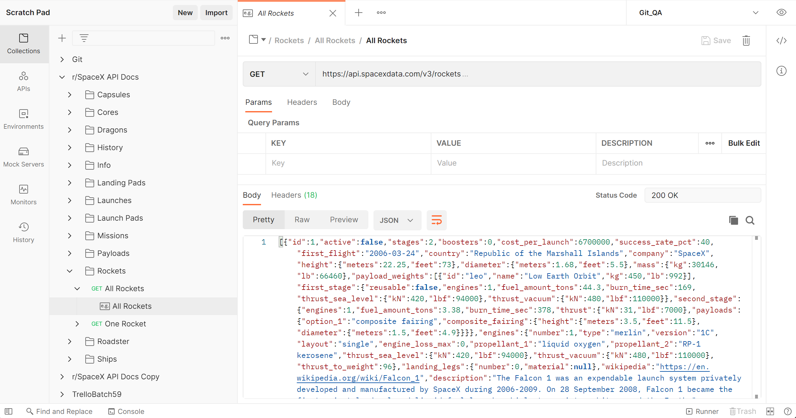
POSTMAN Access to SPACEX API

Slide 7
Extracting Data Using REST API
Space X Data API
Getting the V4 JSON data from the SpaceX data API library
Rocket Data
getBoosterVersion()
Cores Data
getCoreData()
Launch Pad Data
getPayloadData()
Payload Data
getLaunchSite()
Payload Mass Orbit
Booster Version
- Block - ReusedCount - Serial - Outome - Flights - GridFins - Legs - Landing Pad
These columns are collected from Cores JSON data.
Longitude Latitude Launch Site
ID’s for rocket, payload, launchpad and cores are fetched from SPACEX API V4 Json file and using these IDs, more data is then extracted from each of these sub data.

Slide 8
Extracting Data Using Web Scraping
1.
Wikipedia Space X Rocket Data
2.
Extracting all Column Names from HTML table header
3.
Parsing the data to create a Dataframe
Using “requests” and “Beautiful Soup” libraries for python, the data from table available in spaceX Wikipedia is extracted to be parsed in to a padas Dataframe.

Slide 9
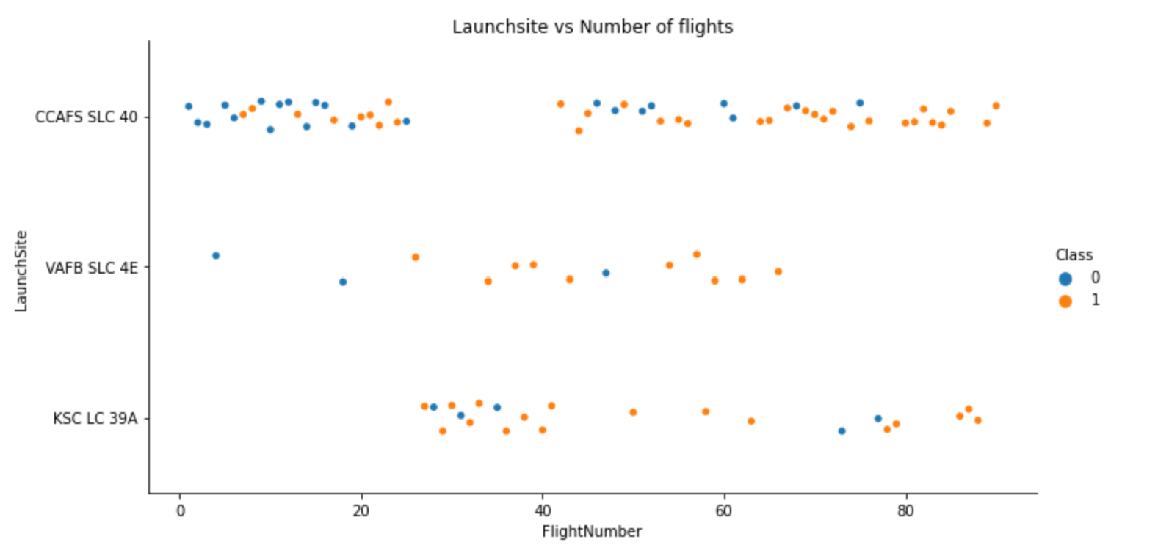
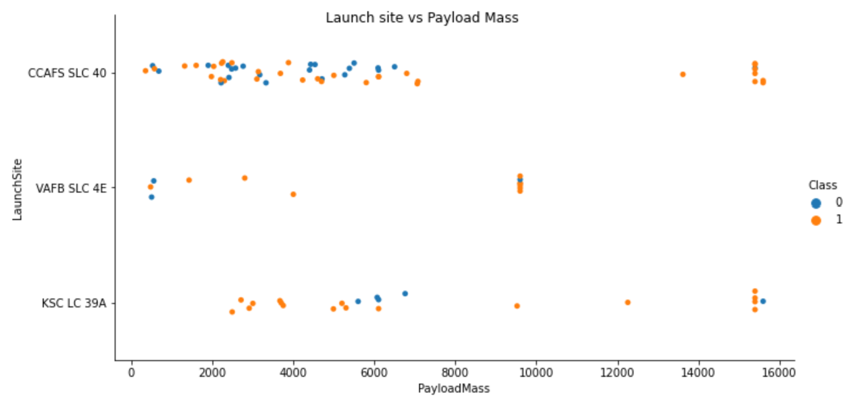
EDA
Most of the successful flights for all of the three-launch site happened at greater many launches or flight number. It also seems the CCAFS has the most amount of launches than any other site.
Now if you observe Payload Vs. Launch Site scatter point chart you will find for the VAFB-SLC launchsite there are no rockets launched for heavy payload mass(greater than 10000). Additionally, highest payload mass has been distributed between CCAFS and KSC launch sites having high success ratio.

Slide 10
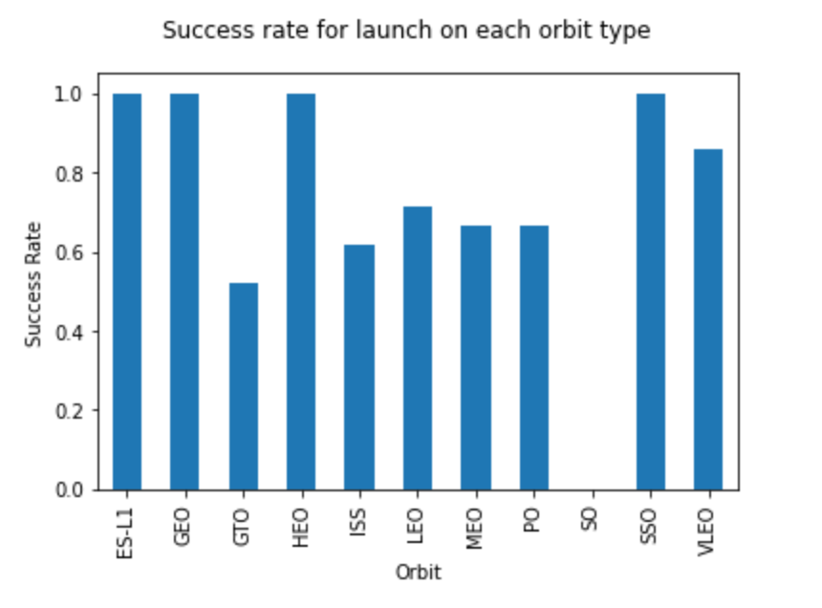
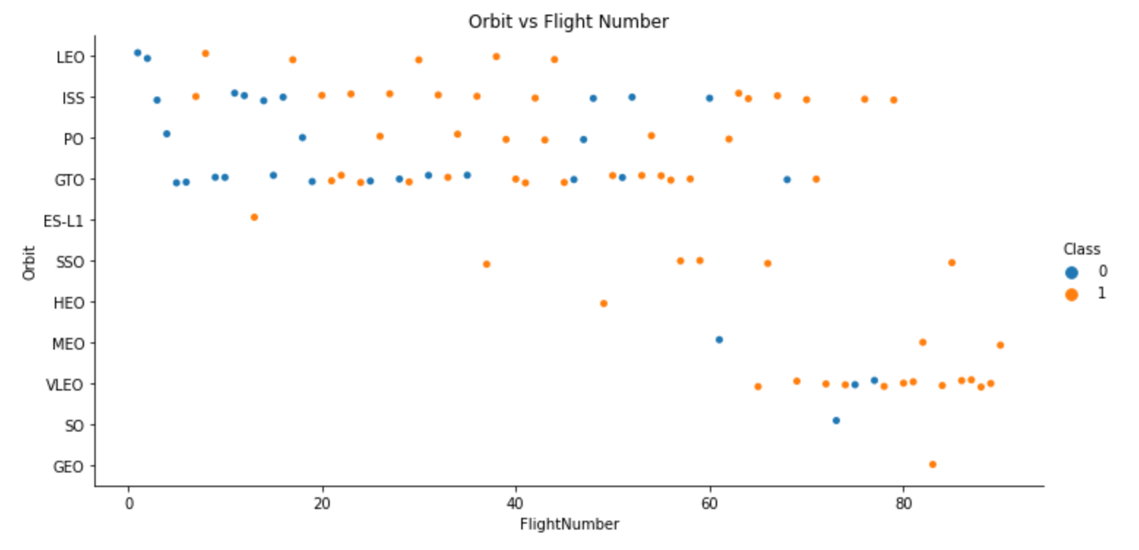
EDA – continued..
It appears that ES-L1, GEO, HEO and SSO are the orbits having the highest success rate of launch.
You should see that in the LEO orbit the Success appears related to the number of flights; on the other hand, there seems to be no relationship between flight number when in GTO orbit. As the number of flights increased the success ratio is also increased among all orbits however most being in the lower earth orbit below SSO.

Slide 11
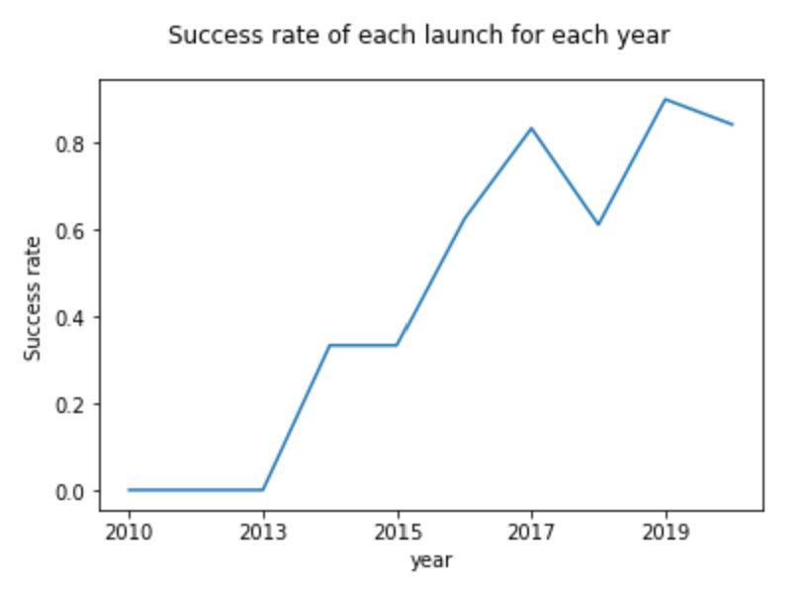
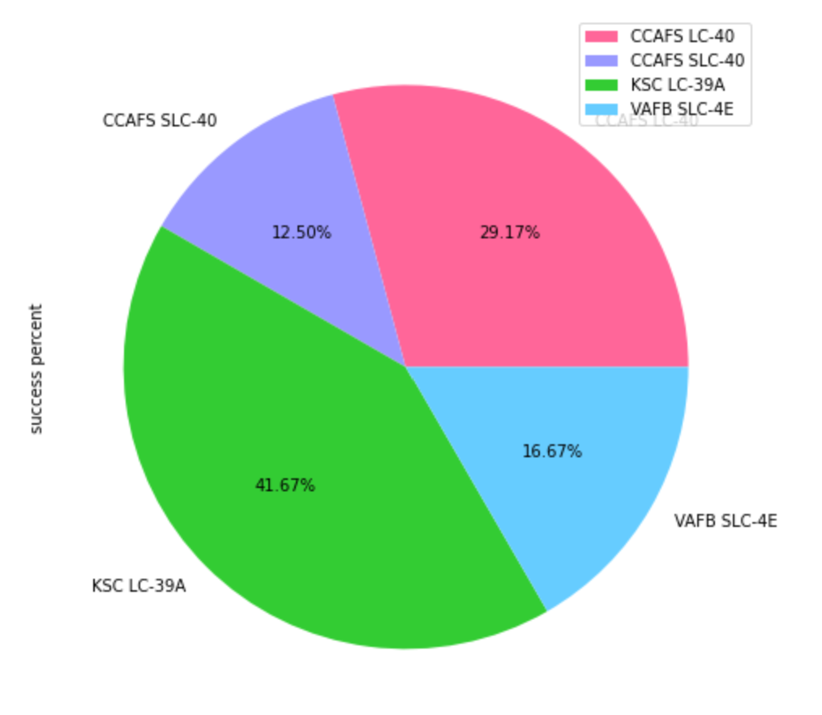
Data Visualization Insight
The success rate of the launches has a steep rise after 2013 with a slight dip in 2018.
KSC LC has the most the successful rocket launches from its site, while least successful being CCAFS.

Slide 12
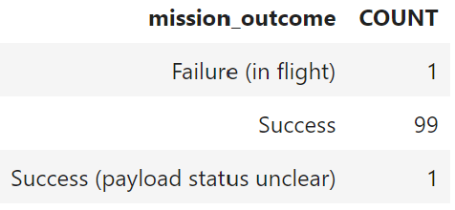
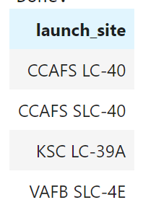
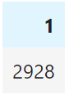
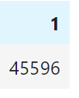
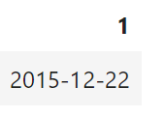
EDA USING SQL
- List the total number of successful and failure mission outcomes
- Display average payload mass carried by booster version F9 v1.1
- List the date when the first successful landing outcome in ground pad was achieved.
IBM DB2 has been used to connect to IBM database and querying the data using SQL.
Results of few questions asked:
- Display the names of the unique launch sites in the space mission
Display the total payload mass carried by boosters launched by NASA (CRS)

Slide 13
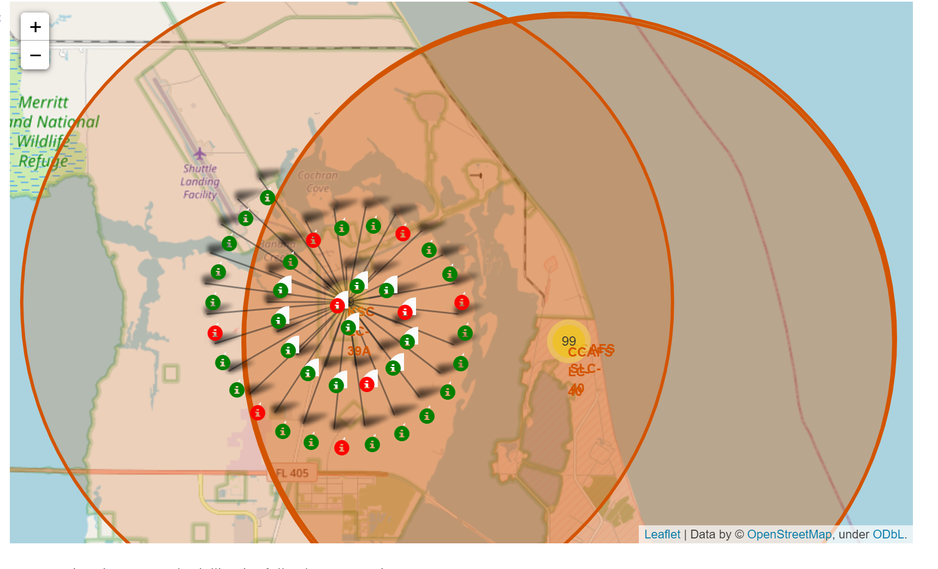
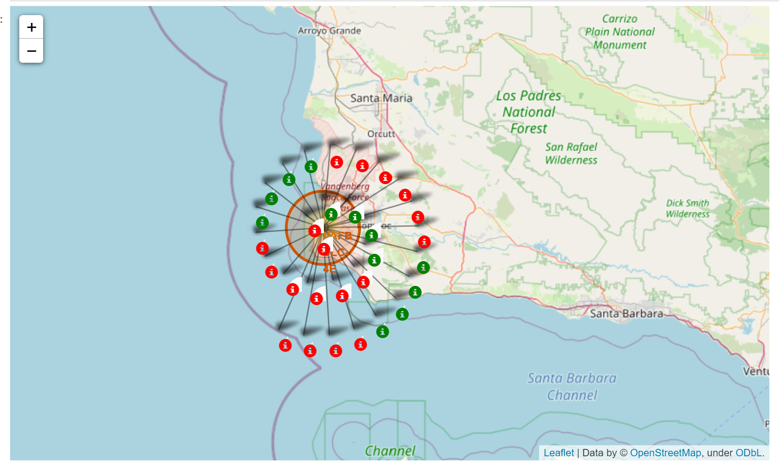
RESULTS USING FOLIUM
The map on right shows 39 launches from the site KSC LC with green markers being the successful one and red being unsuccessful.
The map on left shows 30 launches from the site VFAB with green markers being the successful one and red being unsuccessful.

Slide 14
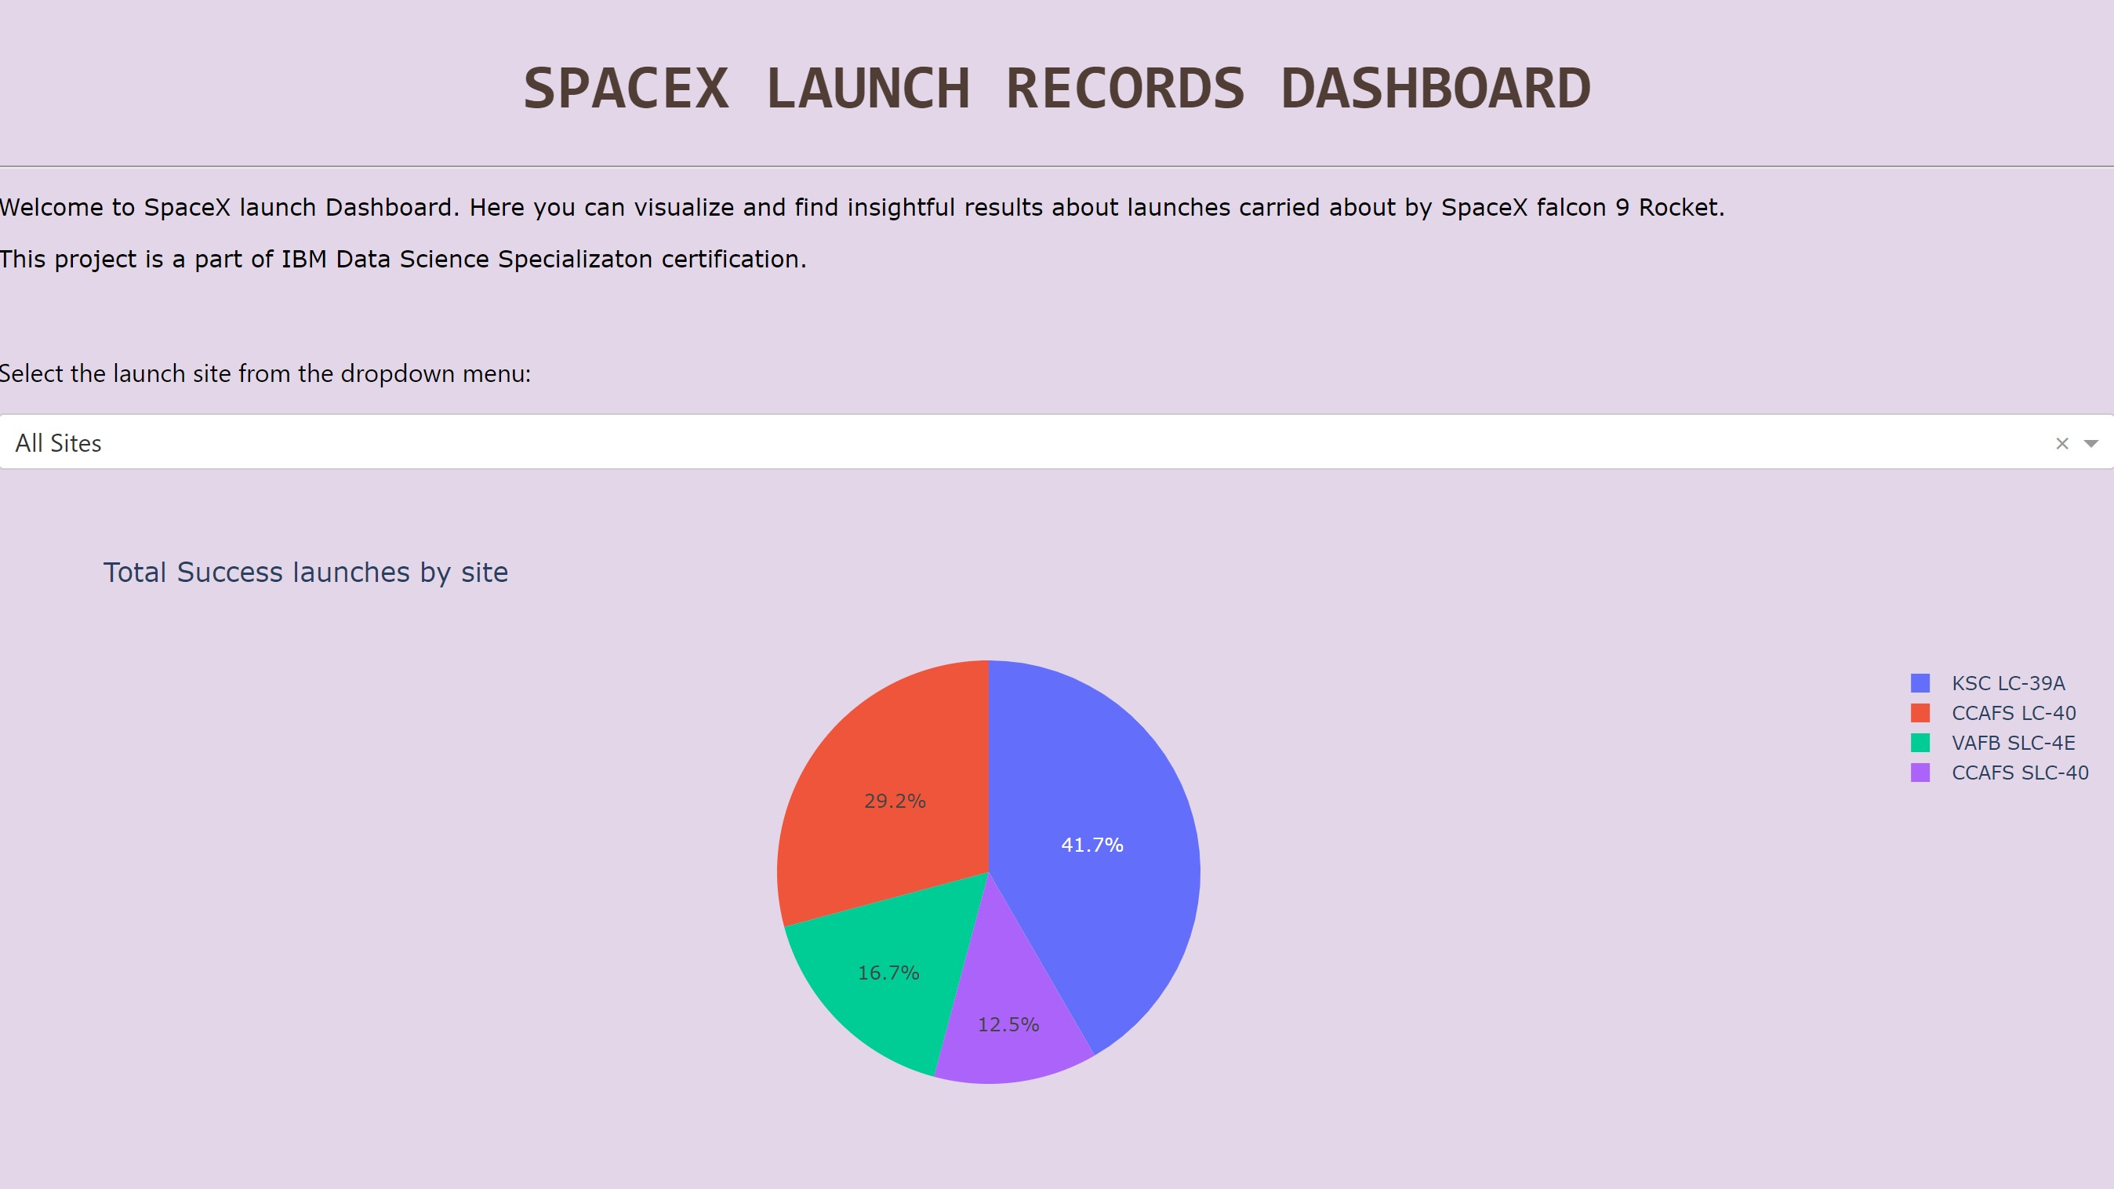
DASHBOARD – All Sites selected

Slide 15
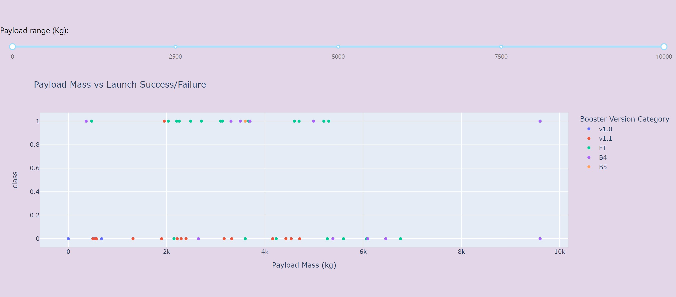
DASHBOARD – All sites selected

Slide 16
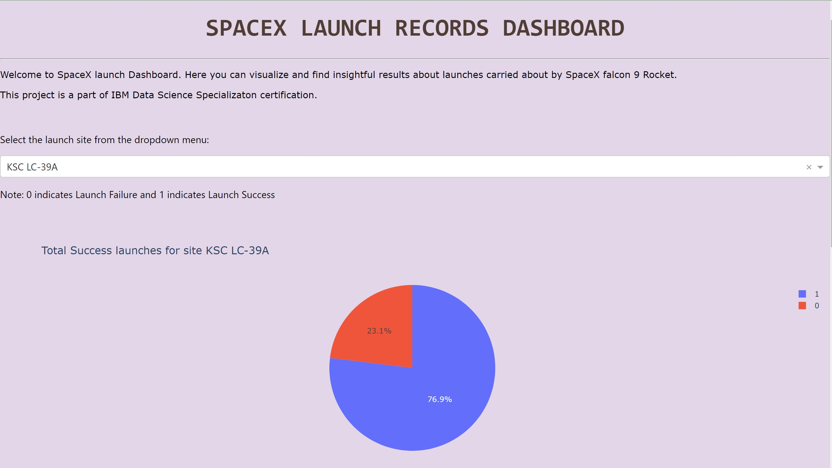
DASHBOARD for KSC LC

Slide 17
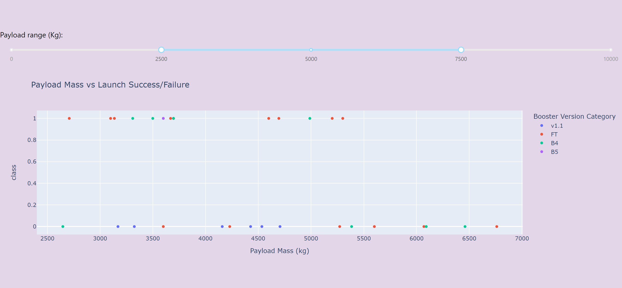
DASHBOARD – Limited Payload Range

Slide 18
Results on Dashboard
Following are some insights from Dashboarding:
KSC LC has the largest number of successful launches.
Again, KSC LC 39A has highest success rate among all sites.
Rockets carrying payload between 2000-4000 kg appears to have highest success rate while rockets having payload higher than 6000 kg has lowest success rate.
Booster Version FT is most successful to launch the payload in range 2k-4k kg.

Slide 19
PREDICTIVE ANALYSIS METHOD:
Predictive modeling is carried on the dataset to determine whether the rocket will land successfully or not. For this purpose, following steps are performed as a part of predictive analysis:
Load the data and find the list of dependent features as well as predictive variable, that will be Class in our case.
Standardize the data for higher accuracy of the model by scaling the values in same range for all columns. This step is carried out after One hot Encoding for categorical data like Orbit of satellite deployment.
Transformed data is then divided into training and testing set.
Selecting best set of hyper-parameters using Sklearn’s GridSerachCV for all four algorithms chosen for prediction.

Slide 20
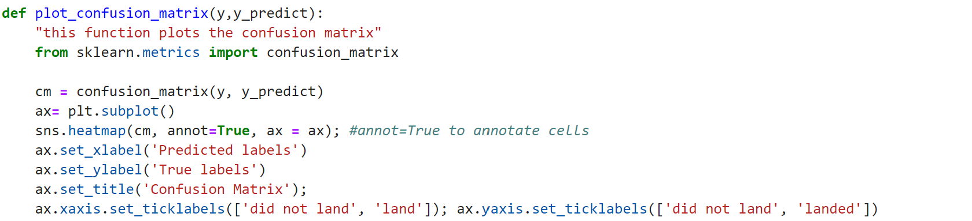
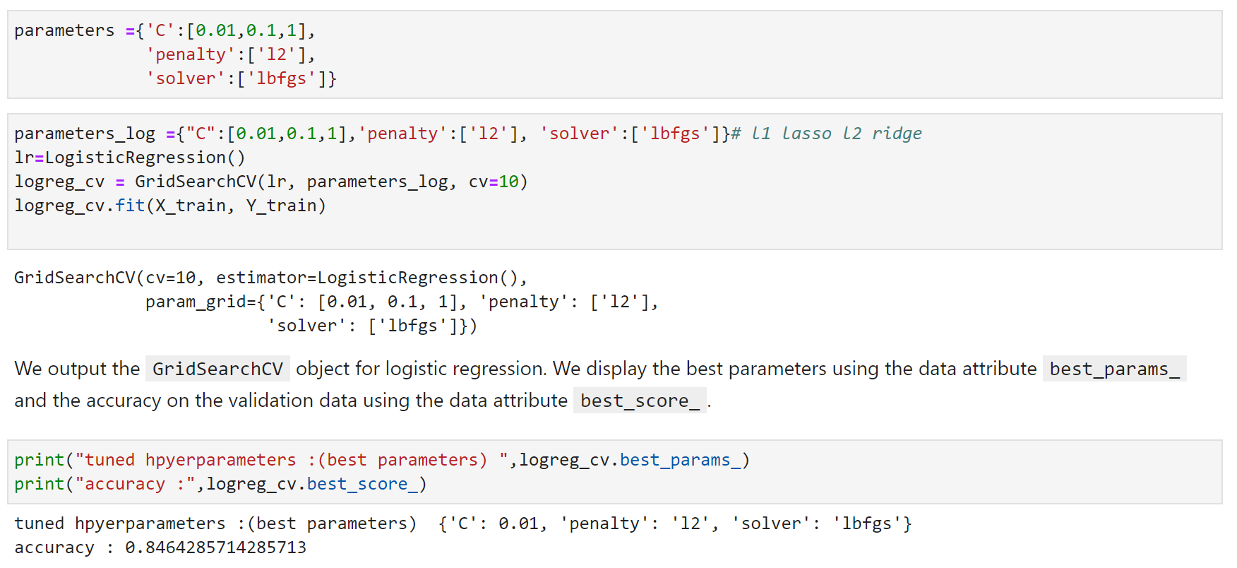
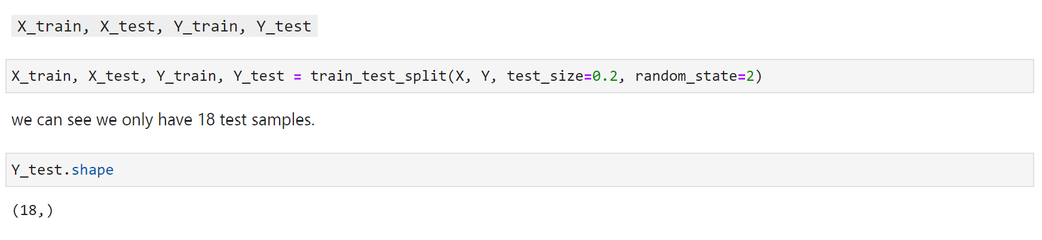
PREDICTIVE ANALYSIS METHOD:
Confusion Matrix function declaration.
Finding the set of hyper parameters
Splitting data into training and testing set.

Slide 21

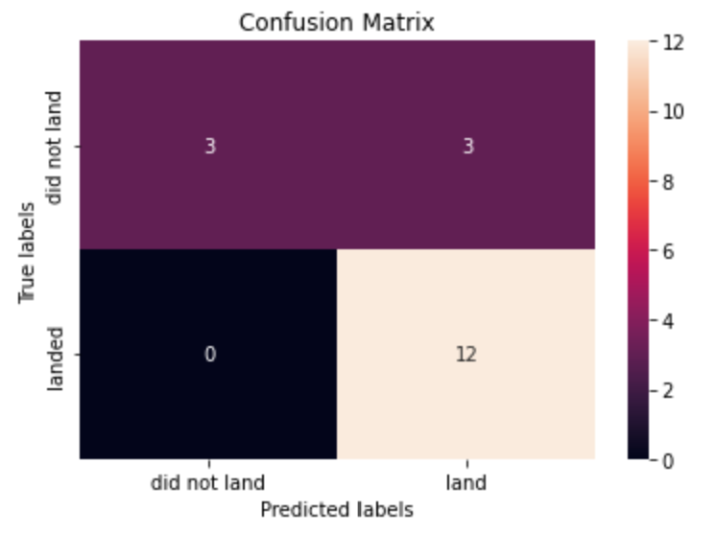
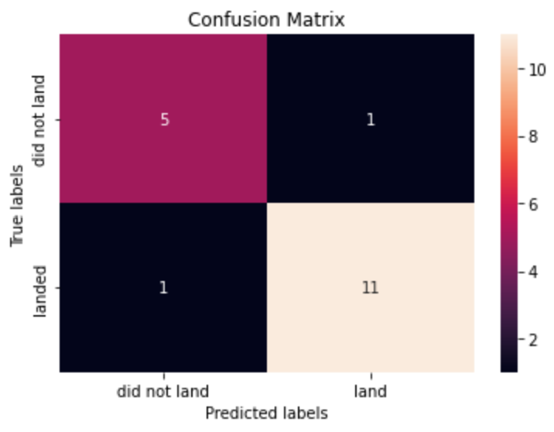
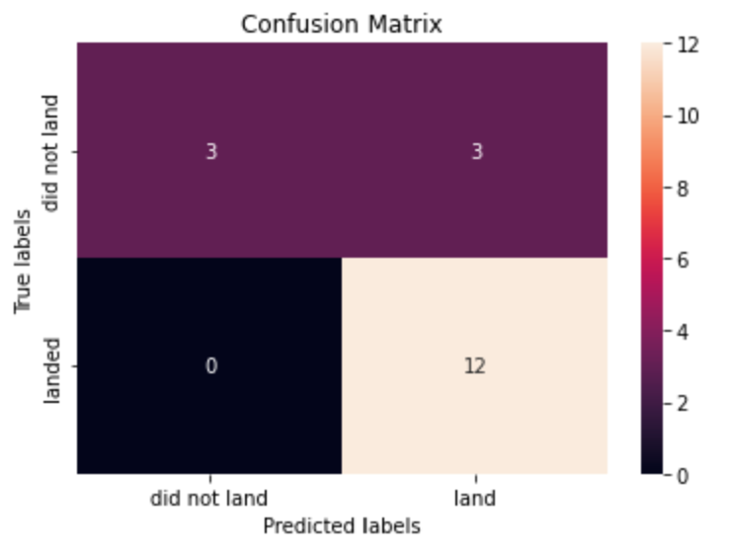
PREDICTIVE ANALYSIS Results:
Logistic Regression
SVM Classifier
Decision Trees
KNN classifier
Accuracy: 83.33 %
Accuracy: 83.33 %
Accuracy: 88.88 %
Accuracy: 83.33 %
Only Decision Tree classifier has lower False Positive and False Negative giving the highest accuracy among all models. Hence Decision Tree Classifier is best the model for Predictive Analysis.

Slide 22

DISCUSSION
The raw data is continuously added on Wikipedia, and it would be interesting to see the prediction accuracy with more amount of data. The more the data, the more accuracy on findings and concrete conclusions.

Slide 23

CONCLUSION
Space X falcon 9 launches had 66.66% successful landings which were distributed across 3 launch sites and the deployment of satellites distributed in 11 different orbits.
Falcon 9 rockets launched from KSC will be more successful than other launch sites and any payload mass between 2k-4k will have higher chances of successful mission.
Landing success depends on many features like the physical working attributes of a rocket, orbit of payload deployment, etc.
All the sites are close to important transportation needs and near the sea cost. VAFB site has the closest access to NASA railroad network.

Slide 24

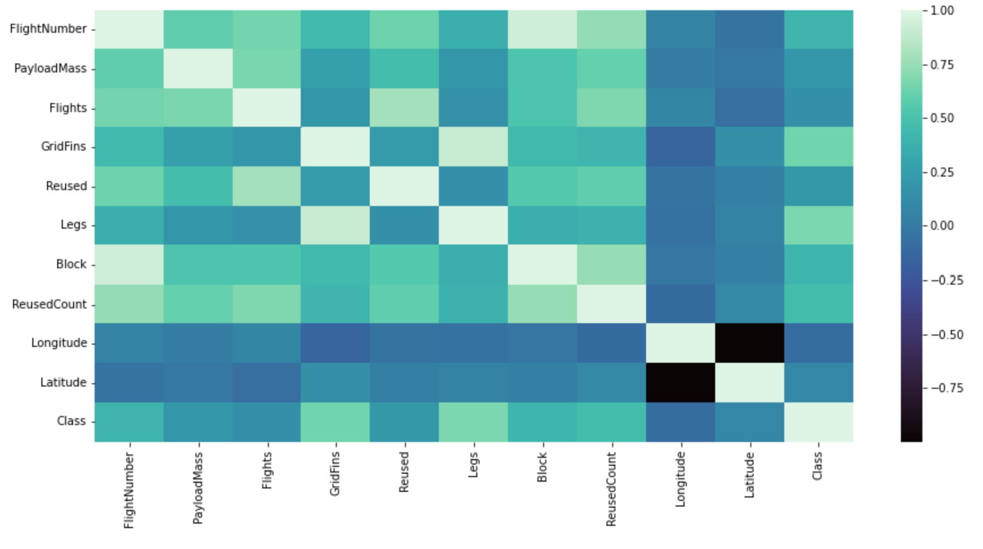
APPENDIX
Correlation Matrix to see which parameter is closely dependent or related to Class (Output label).

